Slide 1
DEPARTMENT OF CULTURE AND TOURISM · FINANCE — i-FINANCE GL
Tourism Sector
Project Budget Utilization — FY2026
Executive briefing — budget vs. execution, open commitments and month-over-month delivery
Prepared 6 July 2026 · Source: i-Finance General Ledger — Budget Utilization (live)

Slide 2
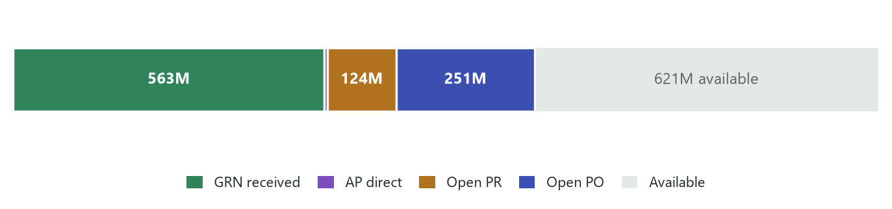
Executive summary
FY2026 · Tourism
FY2026 project budget position — all figures AED, year-to-date through 6 July 2026
APPROVED BUDGET
ACTUAL SPEND
OPEN COMMITMENTS (PR)
OPEN OBLIGATIONS (PO)
FUNDS AVAILABLE
1.56B
568.1M
124.4M
250.6M
620.9M
140 projects · 8 cost centres
36.3% utilised (GRN 563M + AP 5M)
reserved requisitions
orders awaiting delivery
39.7% of budget uncommitted
How the budget sits today
▪ 60% of the budget is already deployed or spoken for — actual 568.1M (36.3%) plus 375.0M of open PR/PO commitments leave 620.9M genuinely free.
▪ Execution is procurement-led — over 99% of actual spend arrives through goods/services receipts (GRN) rather than direct invoices — delivery follow-through drives utilisation.
▪ Concentration — Tourism (Central) holds 76% of the sector budget; its execution pattern defines the sector curve.

Slide 3
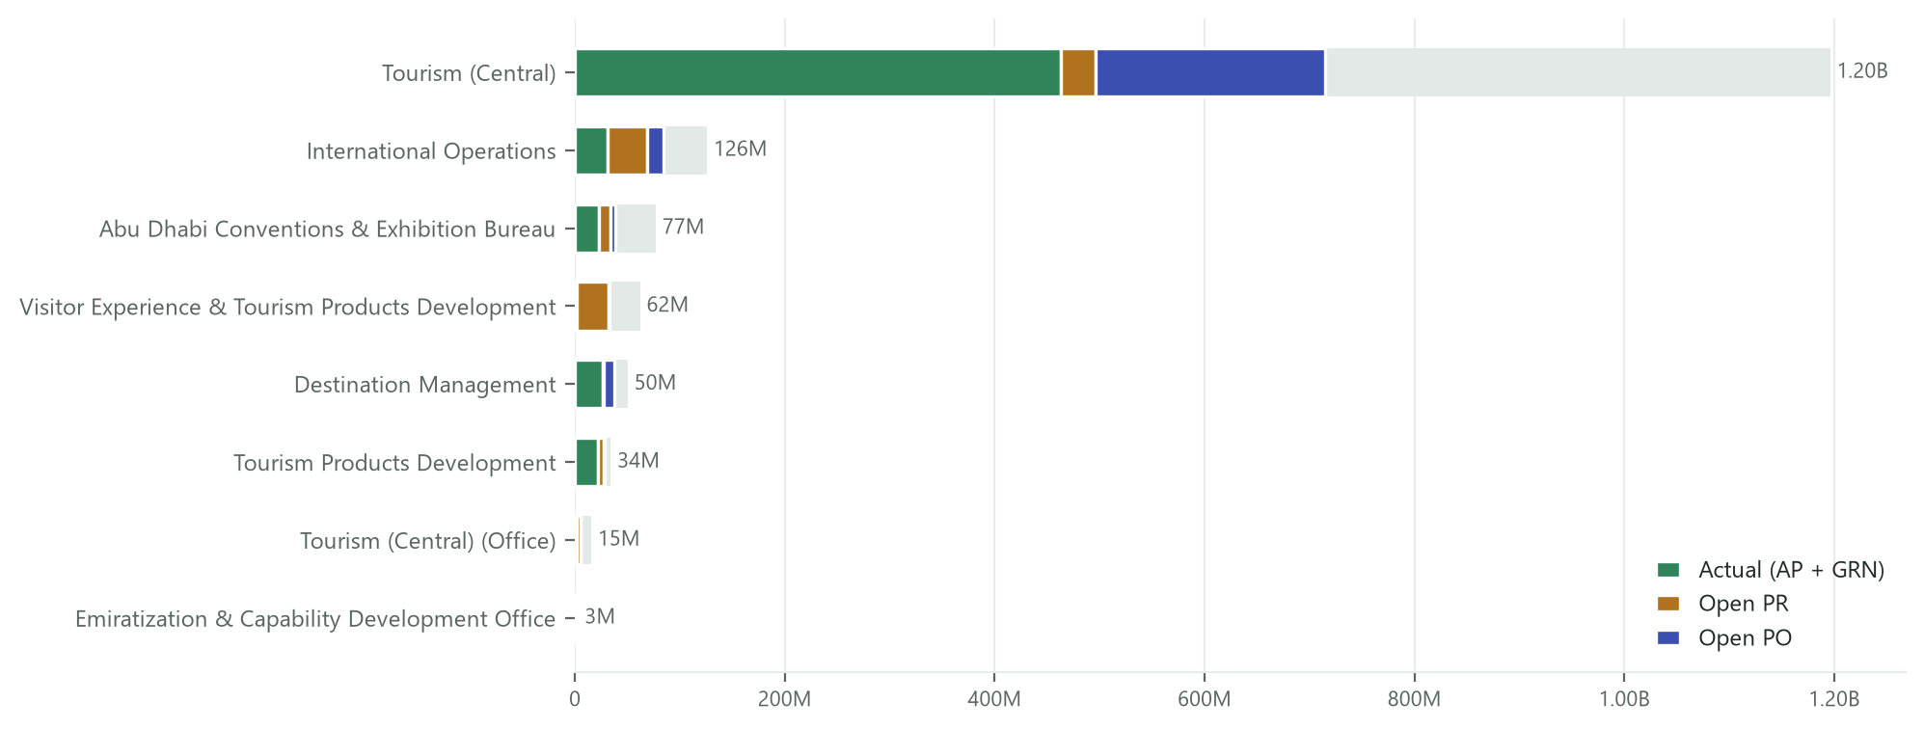
Budget by cost centre
FY2026 · Tourism
Approved budget (track) vs. actual spend and open commitments — AED
Bars show each cost centre’s full budget (grey track); coloured segments are actual spend and open PR/PO within it. Budget value at bar end.

Slide 4
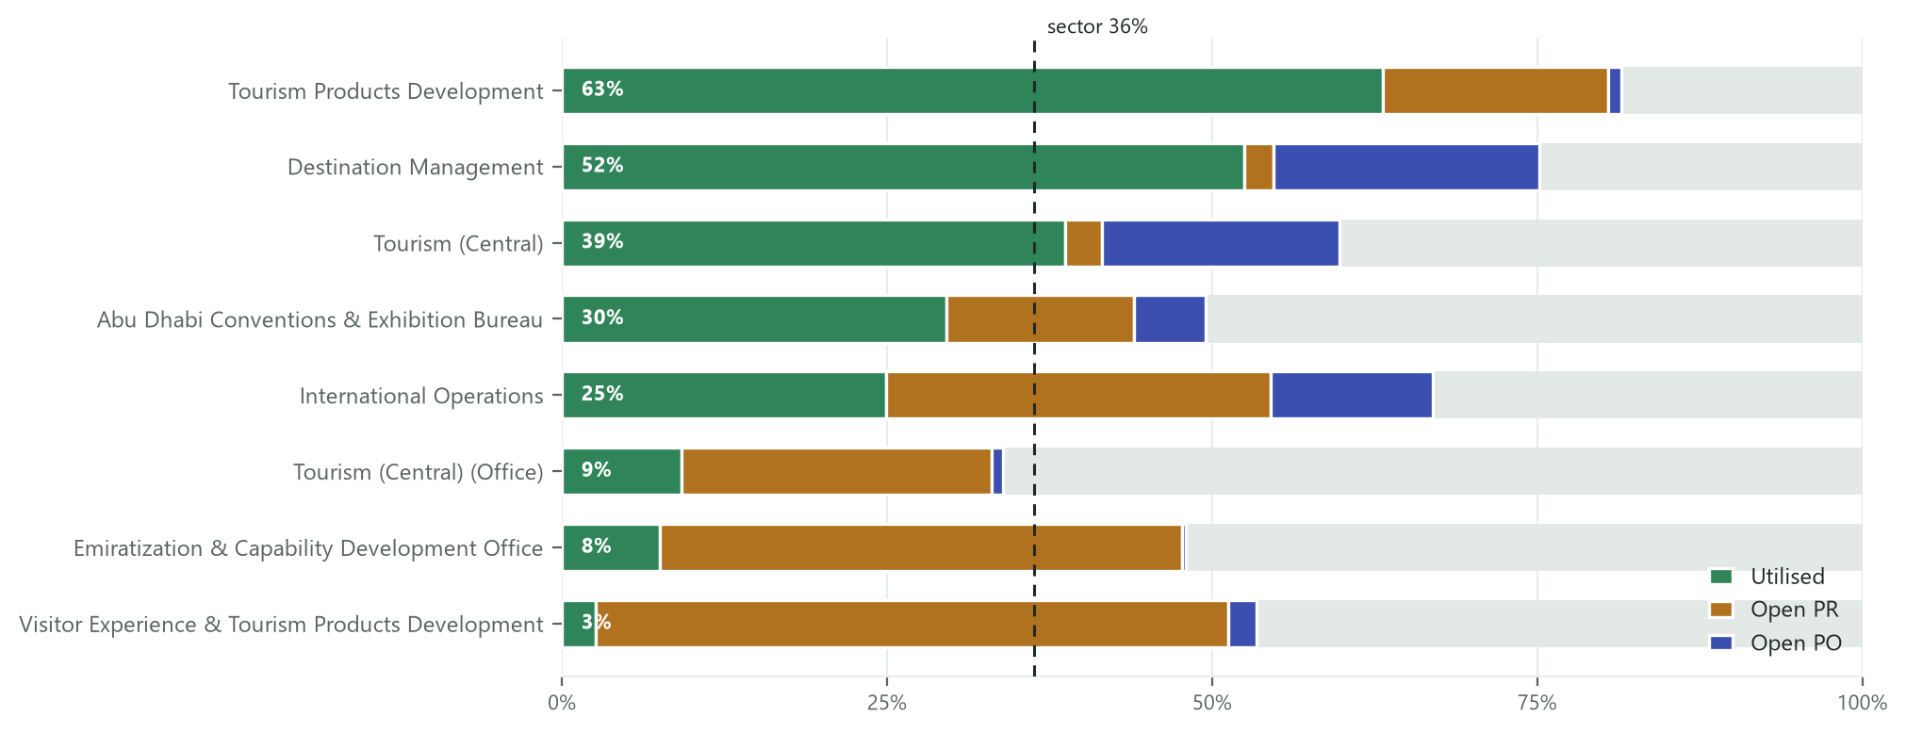
Utilisation ranking
FY2026 · Tourism
Share of each cost centre’s own budget — utilised, reserved (PR) and on order (PO)
Dashed line = sector utilisation (36.3%). A low utilised share with a large amber/indigo block means the pipeline is committed but not yet delivered.

Slide 5
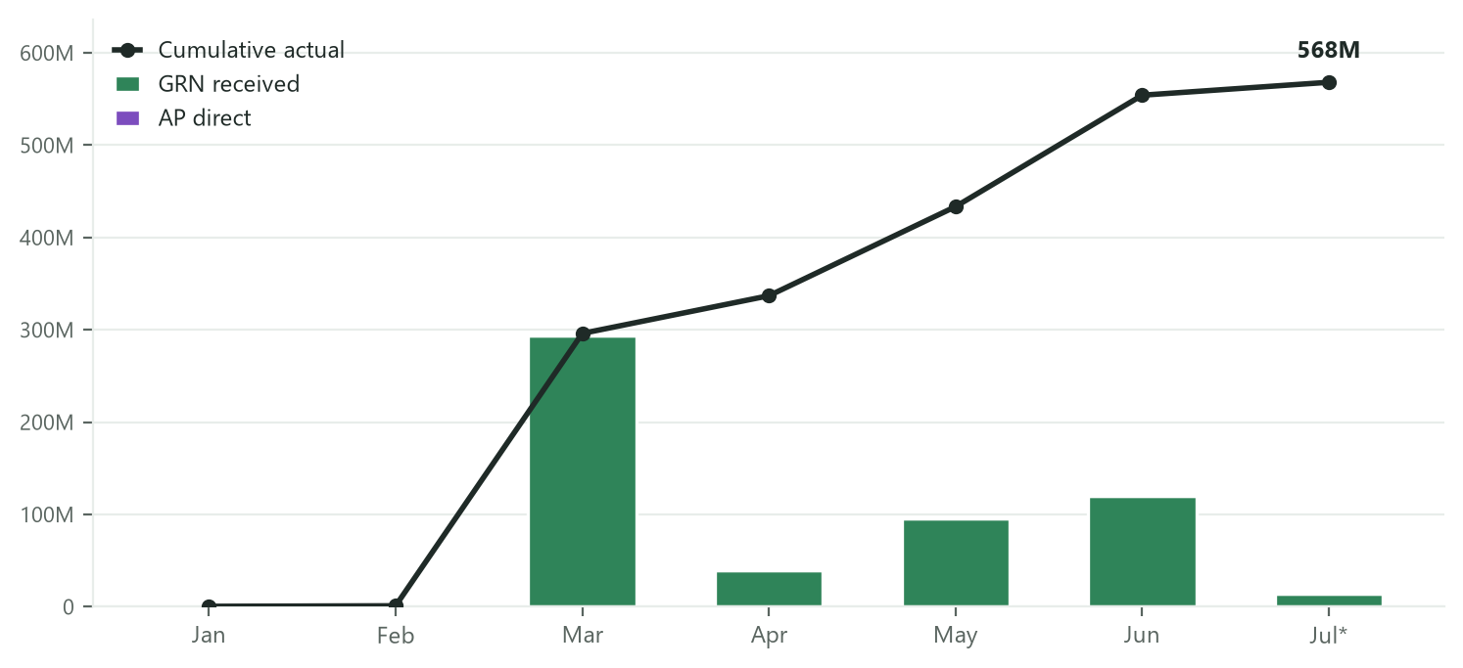
Month-over-month execution
FY2026 · Tourism
Monthly actual spend (GRN + AP direct) with cumulative curve — AED
* July is month-to-date (through 6 Jul). March reflects a major receipt cycle at Tourism (Central) — execution lands in steps as deliveries are receipted, not in a straight line.

Slide 6
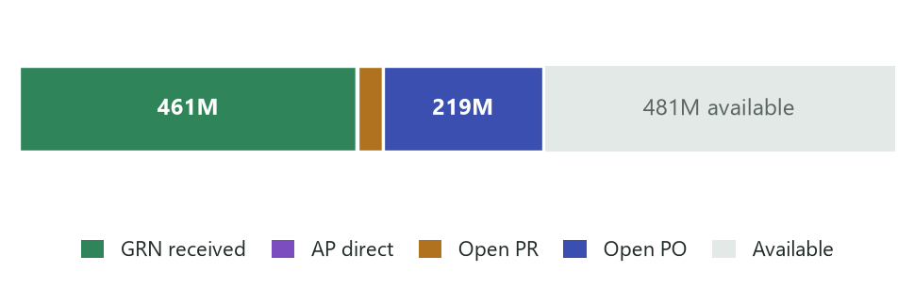
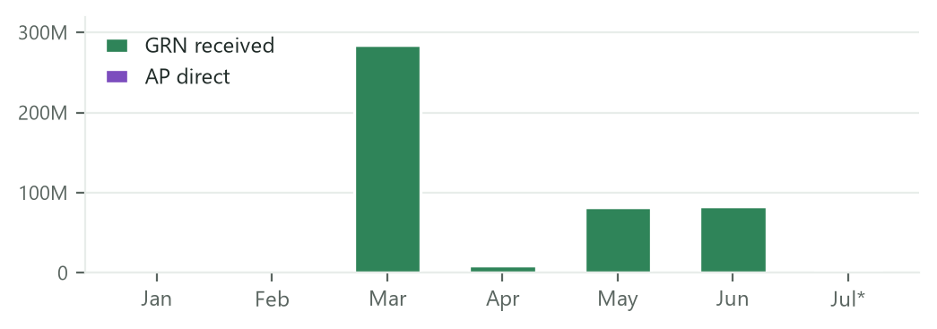
Tourism (Central)
FY2026 · Tourism
Cost centre 4515500 · 51 projects · deep dive
BUDGET
ACTUAL
OPEN PR
OPEN PO
AVAILABLE
1.20B
462.7M
33.8M
218.6M
480.8M
76.5% of sector
38.7% utilised
2.8% of budget
18.3% of budget
40.2% of budget
Budget composition
Monthly execution (AED)
Top projects by budget
Project | Budget | Actual | Committed (PR+PO) | Available
4511000725 — NBA- Basket Ball Development | 148.1M | 59.2M | 76.0M | 12.8M
4511000809 — Liwa Festival | 138.1M | 35.6M | 22.0M | 80.4M
4511000403 — TS - EB - G21 - M JV | 126.5M | 103.0M | 0 | 23.5M
4511000386 — TS - EB- UFC | 107.7M | 36.7M | 59.3M | 11.7M
4511001136 — Saadiyat Festival | 107.2M | 88.3M | 7.9M | 10.9M

Slide 7
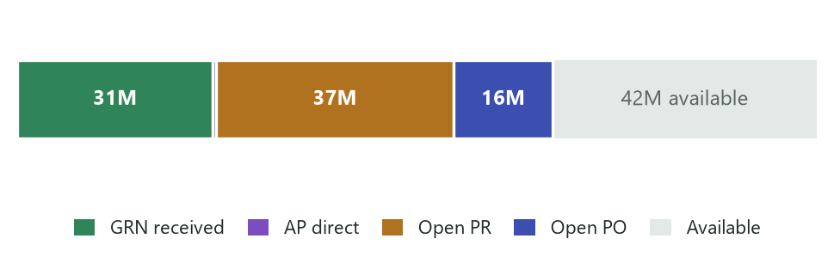
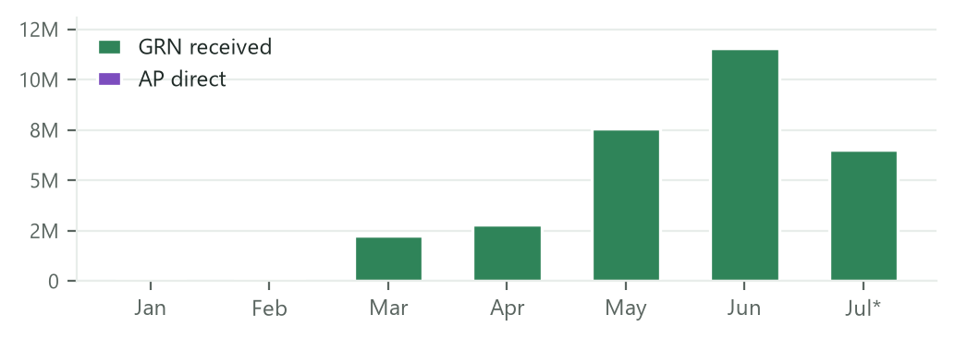
International Operations
FY2026 · Tourism
Cost centre 4515100 · 12 projects · deep dive
BUDGET
ACTUAL
OPEN PR
OPEN PO
AVAILABLE
125.8M
31.3M
37.3M
15.7M
41.5M
8.0% of sector
24.9% utilised
29.6% of budget
12.4% of budget
33.0% of budget
Budget composition
Monthly execution (AED)
Top projects by budget
Project | Budget | Actual | Committed (PR+PO) | Available
4511001474 — Exhibitions | 27.6M | 13.9M | 1.1M | 12.5M
4511000572 — TTMD Global Partnerships | 21.8M | 2.0M | 18.6M | 1.2M
4511001472 — Europe-Tier-1 | 15.1M | 4.0M | 5.0M | 6.0M
4511001471 — APAC-Tier-1 | 14.0M | 1.2M | 7.0M | 5.8M
4511001475 — Europe-Tier-2 | 12.5M | 2.8M | 3.5M | 6.2M

Slide 8
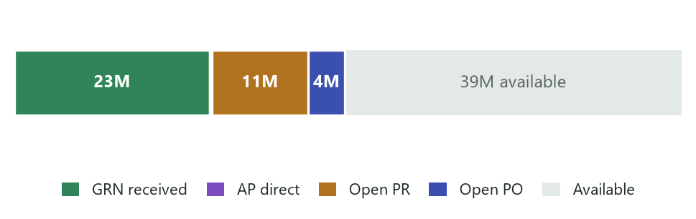
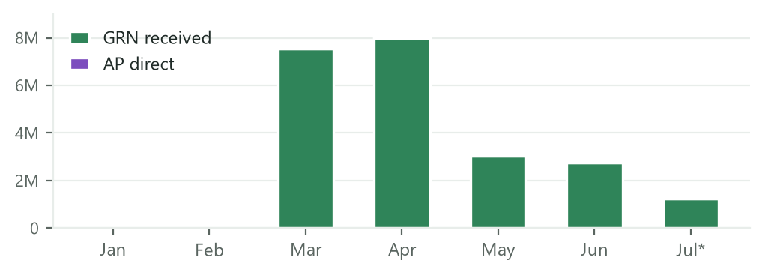
Abu Dhabi Conventions & Exhibition Bureau
FY2026 · Tourism
Cost centre 4515400 · 31 projects · deep dive
BUDGET
ACTUAL
OPEN PR
OPEN PO
AVAILABLE
77.0M
22.8M
11.1M
4.3M
38.9M
4.9% of sector
29.6% utilised
14.4% of budget
5.6% of budget
50.5% of budget
Budget composition
Monthly execution (AED)
Top projects by budget
Project | Budget | Actual | Committed (PR+PO) | Available
4511000981 — Advantage AD Scheme | 48.3M | 14.9M | 6.3M | 27.1M
4511000798 — Develop Meeting & Incentives | 9.0M | 5.3M | 487K | 3.3M
4511001506 — Abu Dhabi MICE Strategy Refresh | 5.5M | 0 | 3.0M | 2.5M
4511000175 — TS-PRO-IMEX | 4.8M | 1.8M | 2.4M | 506K
4511000943 — B.D - Association Convention | 1.4M | 426K | 406K | 604K

Slide 9
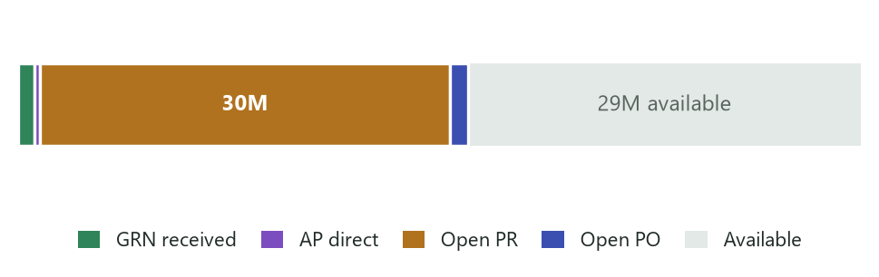
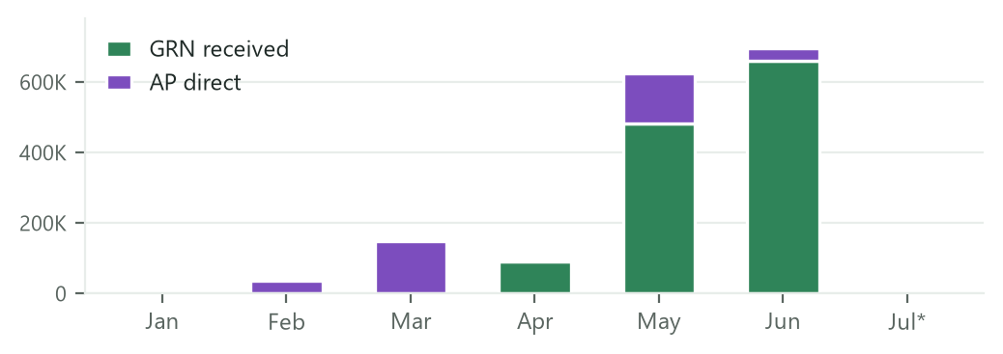
Visitor Experience & Tourism Products Development
FY2026 · Tourism
Cost centre 4515300 · 14 projects · deep dive
BUDGET
ACTUAL
OPEN PR
OPEN PO
AVAILABLE
62.1M
1.6M
30.2M
1.3M
28.9M
4.0% of sector
2.6% utilised
48.6% of budget
2.2% of budget
46.6% of budget
Budget composition
Monthly execution (AED)
Top projects by budget
Project | Budget | Actual | Committed (PR+PO) | Available
4511001537 — VX Signature Moments | 17.9M | 0 | 7.0M | 10.9M
4511000978 — Service standards Manual | 10.1M | 359K | 2.5M | 7.3M
4511001539 — VX Incentives & Control | 7.7M | 0 | 6.6M | 1.1M
4511001005 — VX consultancy services | 7.0M | 153K | 6.4M | 443K
4511001536 — VX Award | 4.6M | 144K | 3.6M | 854K

Slide 10
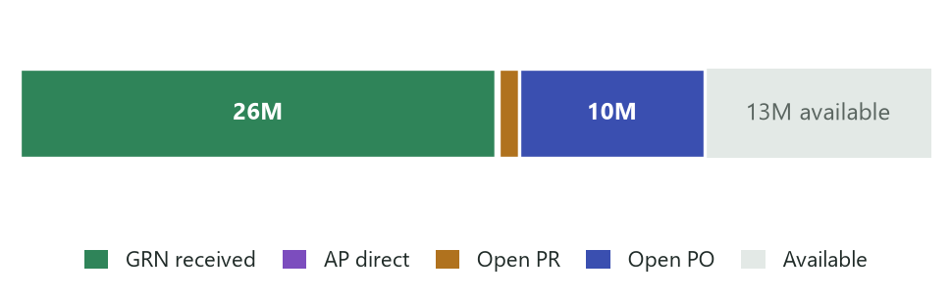
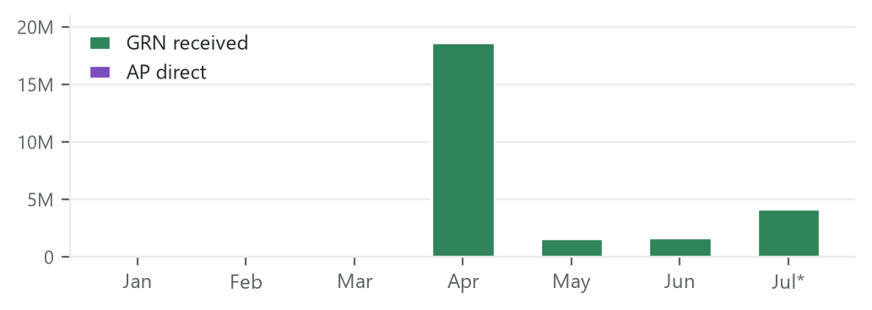
Destination Management
FY2026 · Tourism
Cost centre 4515700 · 4 projects · deep dive
BUDGET
ACTUAL
OPEN PR
OPEN PO
AVAILABLE
50.3M
26.4M
1.1M
10.2M
12.5M
3.2% of sector
52.5% utilised
2.3% of budget
20.4% of budget
24.9% of budget
Budget composition
Monthly execution (AED)
Top projects by budget
Project | Budget | Actual | Committed (PR+PO) | Available
4511000860 — Al Ain Destination Strategy | 24.9M | 7.3M | 7.3M | 10.3M
4511001332 — GHAITAH ALAIN | 21.0M | 17.6M | 3.4M | 0
4511001235 — Shuttle bus across Tourist | 3.0M | 692K | 556K | 1.8M
4511000245 — MC-Abu Dhabi Destination | 1.4M | 797K | 199K | 398K

Slide 11
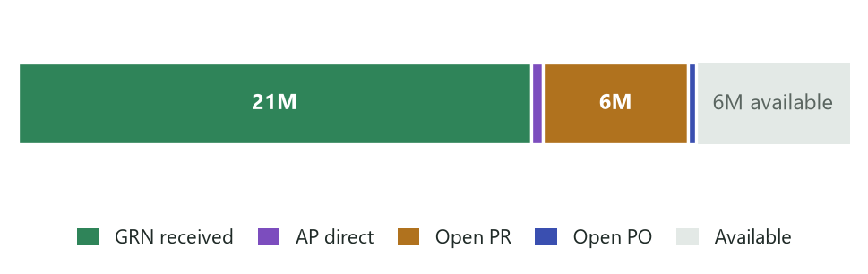
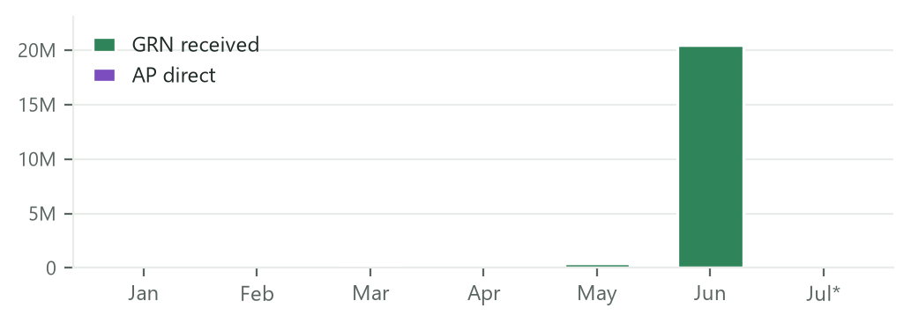
Tourism Products Development
FY2026 · Tourism
Cost centre 4515900 · 13 projects · deep dive
BUDGET
ACTUAL
OPEN PR
OPEN PO
AVAILABLE
34.3M
21.7M
6.0M
338K
6.4M
2.2% of sector
63.1% utilised
17.4% of budget
1.0% of budget
18.5% of budget
Budget composition
Monthly execution (AED)
Top projects by budget
Project | Budget | Actual | Committed (PR+PO) | Available
4511001456 — Home Based Oper. - Air Arabia | 18.5M | 18.1M | 0 | 400K
4511000942 — Destination Wedding | 8.9M | 757K | 4.5M | 3.7M
4511001208 — Exhibition - Monaco Yacht Show | 1.5M | 1.2M | 280K | 21K
4511000935 — Cruise Partnerships | 806K | 186K | 222K | 398K
4511001128 — Product Development-Consultant | 757K | 454K | 0 | 303K

Slide 12
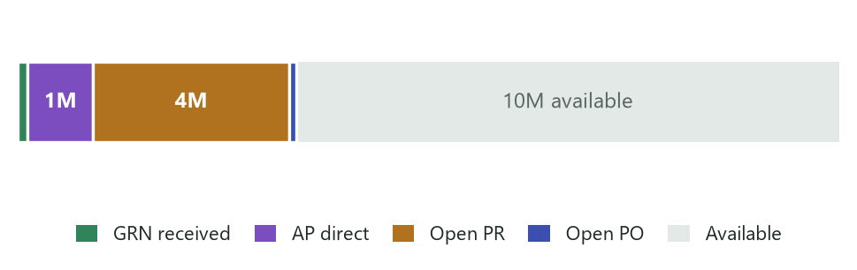
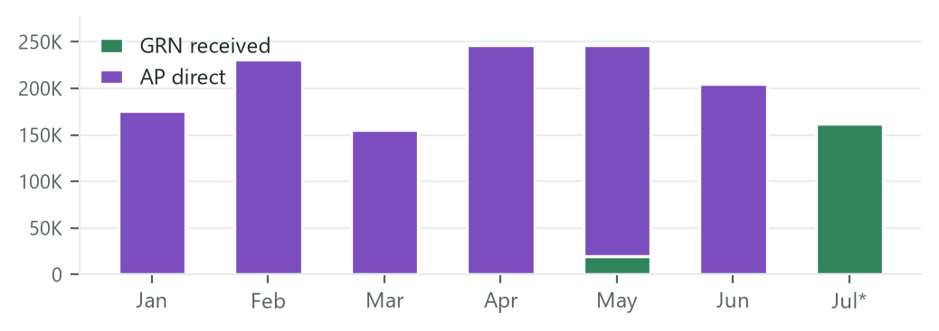
Tourism (Central) (Office)
FY2026 · Tourism
Cost centre 4515010 · 13 projects · deep dive
BUDGET
ACTUAL
OPEN PR
OPEN PO
AVAILABLE
15.5M
1.4M
3.7M
135K
10.2M
1.0% of sector
9.2% utilised
23.8% of budget
0.9% of budget
66.1% of budget
Budget composition
Monthly execution (AED)
Top projects by budget
Project | Budget | Actual | Committed (PR+PO) | Available
4511001134 — Investment-Investor Pitch Book | 4.4M | 0 | 178K | 4.2M
4511000826 — TSM-Sector Management | 4.0M | 1.3M | 95K | 2.6M
4511000972 — Tourism Tactical research | 2.2M | 0 | 322K | 1.9M
4511000809 — Liwa Festival | 1.7M | 0 | 1.6M | 82K
4511001399 — Tourism Sustainability | 1.1M | 0 | 1.1M | 0

Slide 13
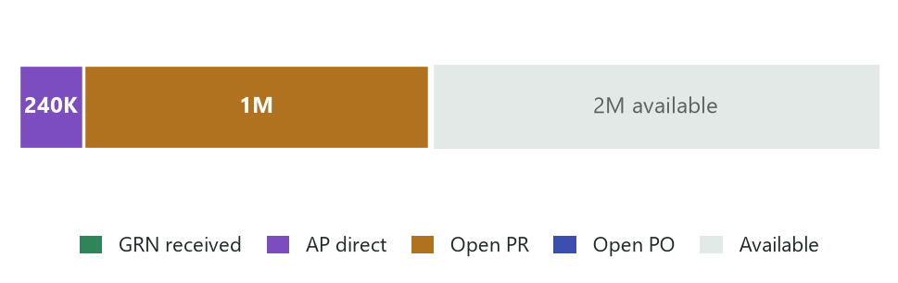
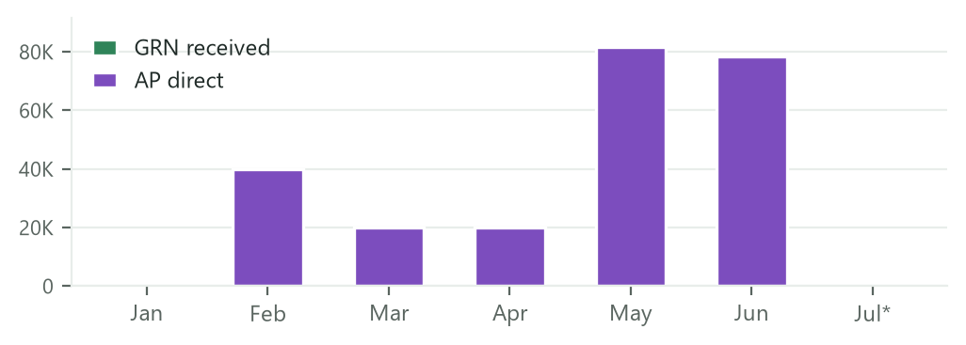
Emiratization & Capability Development Office
FY2026 · Tourism
Cost centre 4515020 · 3 projects · deep dive
BUDGET
ACTUAL
OPEN PR
OPEN PO
AVAILABLE
3.2M
240K
1.3M
10K
1.7M
0.2% of sector
7.5% utilised
40.2% of budget
0.3% of budget
52.0% of budget
Budget composition
Monthly execution (AED)
Top projects by budget
Project | Budget | Actual | Committed (PR+PO) | Available
4511001405 — Strategic Emiratization | 2.3M | 240K | 1.1M | 925K
4511001404 — Industrial Professional Dev. | 765K | 0 | 33K | 733K
4511001406 — Emiratization Market Campaings | 150K | 0 | 150K | 0

Slide 14
Observations & recommended actions
FY2026 · Tourism
What the numbers say — and where management attention pays off
▪ Concentration risk — Tourism (Central) carries 76% of the sector budget (1.20B); sector delivery is effectively this cost centre’s delivery. Recommend a dedicated monthly delivery review for its top-5 projects.
▪ Committed but not delivered = 375.0M (24% of budget) — PO 250.6M awaiting receipts plus PR 124.4M awaiting conversion. Utilisation will step up mechanically as deliveries land — push GRN discipline (receipt on delivery, not at invoice time).
▪ Pipeline stuck at requisition — Visitor Experience & Tourism Products Development is only 3% utilised, yet 49% of its budget (30.2M) is already reserved on requisitions — expedite PR→PO conversion and delivery scheduling.
▪ Run-rate check — actual spend averages ≈ 91.6M/month. With 620.9M free and 375.0M committed, full-year consumption projects close to budget only if committed orders deliver in H2 — track PO ageing monthly.
▪ Low-utilisation watchlist — Tourism Central Office (8.0%) and Emiratization (7.5%) — small budgets, but if unspent by Q3 they are reallocation candidates.
▪ Healthy signal — only 5.1M (0.3%) of spend bypasses procurement as direct AP — strong contract/PO discipline across the sector.

Slide 15
Appendix — definitions & method
FY2026 · Tourism
How each figure is derived (all AED, FY2026)
▪ Approved budget — FY2026 project budget per Project × Task × Expenditure Type (Fusion projects budget extract).
▪ Actual — GRN received — value of goods/services receipted against purchase orders (receipt date in FY2026).
▪ Actual — AP direct — validated supplier invoices charged directly to a project with no purchase order.
▪ Open commitments (PR) — requisition lines with funds status Reserved — budget held, order not yet placed.
▪ Open obligations (PO) — purchase-order lines Reserved / Partially Liquidated, net of receipts to date.
▪ Funds available — Budget − Actual AP − Actual GRN − Open PR − Open PO.
▪ Source — i-Finance General Ledger (App 210) — Budget Utilization report over DCT_BUDGET_UTILIZATION_V; monthly split reconciles to the report’s drill-down. Data as of 6 July 2026; July is month-to-date.

